Slide 1
Disclaimer
This training resource was developed to be used with the CZ ID platform
In October, 2026, stewardship of CZ ID transitioned to UCSF and the platform was renamed to SeqtoID
These training materials are not being actively maintained and may not reflect differences between CZ ID and SeqtoID, subsequent changes to the platform, or current methods and best practices in metagenomic sequencing and analysis

Slide 2

Heatmaps
Rapid Response – Updated Sept 2026
Notes:
Slides updated 07/02/2024

Slide 3
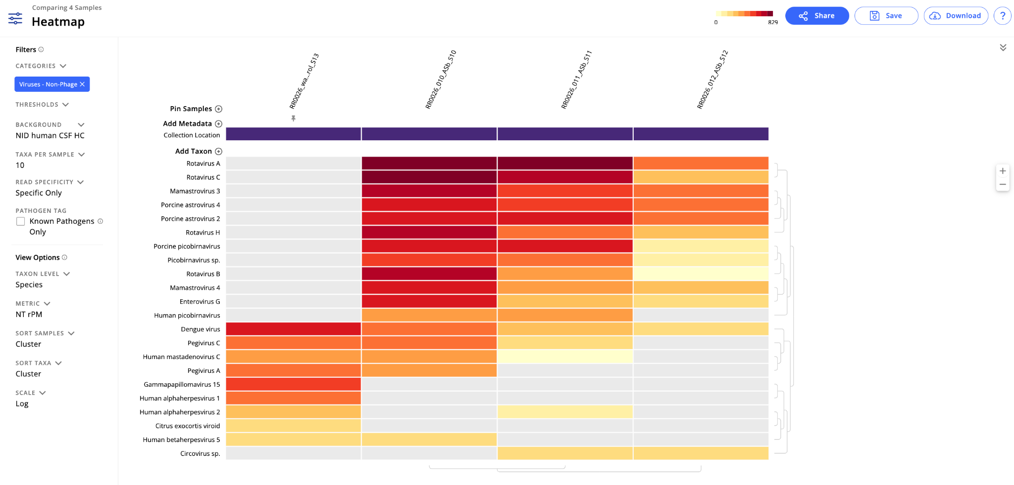
Heatmap: Enables you to visually compare detected taxa across samples and quickly spot microbes of interest

Slide 4
Heatmap Layout
Scale
(default: NT rPM)
Samples
Taxa
Notes:
Rows = taxa
Columns = samples

Slide 5
Taxa and samples are organized through hierarchical clustering
Notes:
When you first open the heatmap, the samples and taxa are not organized randomly

Slide 6
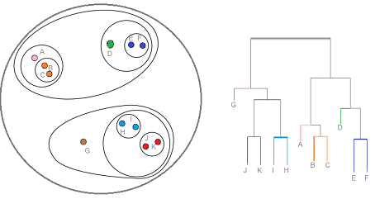
Clusters are represented using a dendogram
1
1
2
2
1
Image source
Clusters: Groups that include similar samples based on co-occurring taxa and their relative abundance
Dendogram: Tree representation of the data (clusters = clades)

Slide 7
Clusters are represented using a dendogram
1
1
2
2
1
Image source
Clusters: Groups that include similar samples based on co-occurring taxa and their relative abundance
Dendogram: Tree representation of the data (clusters = clades)

Slide 8
Taxa and samples are organized through hierarchical clustering
Taxa that are in a clade (or cluster) are more likely to appear together across samples.
Samples that are clustered together have similar taxa.
Notes:
Example - contaminants are more likely to cluster together bc they all are introduced together/similar source

Slide 9
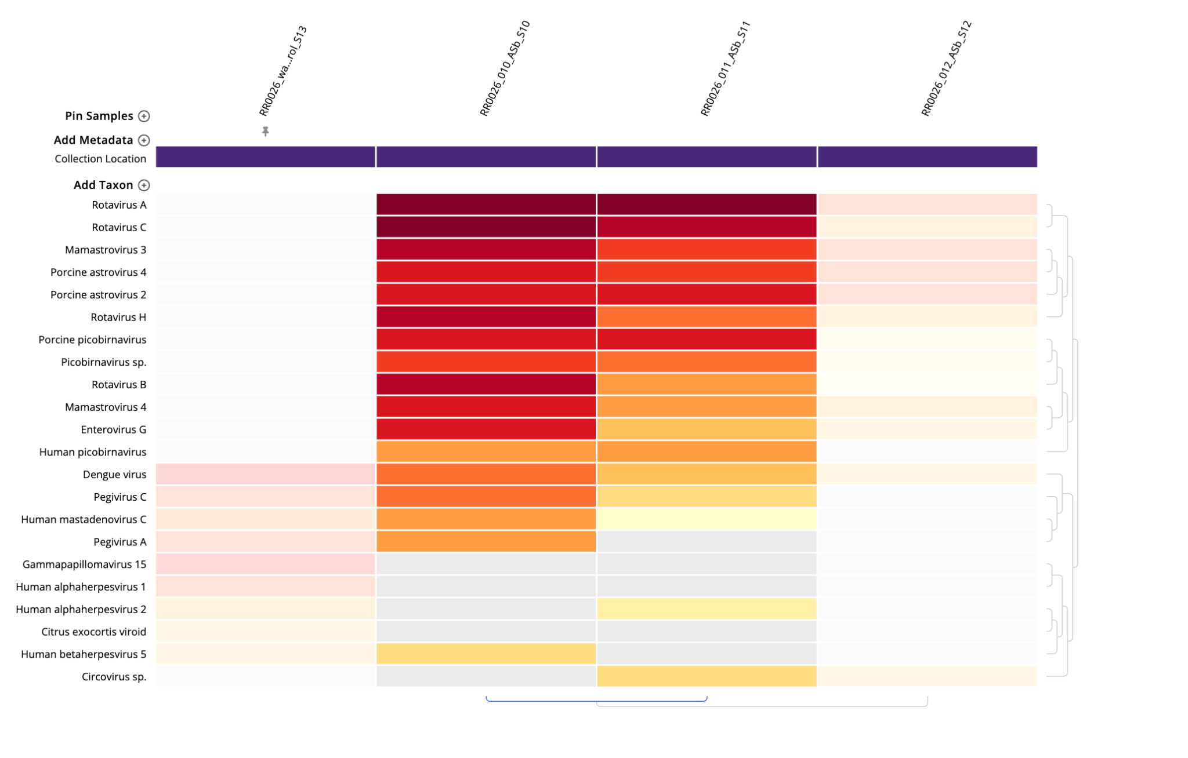
Identify clusters of interest
Clade of interest
Notes:
What are some reasons these samples clustering together? (biological or batch or…)

Slide 10
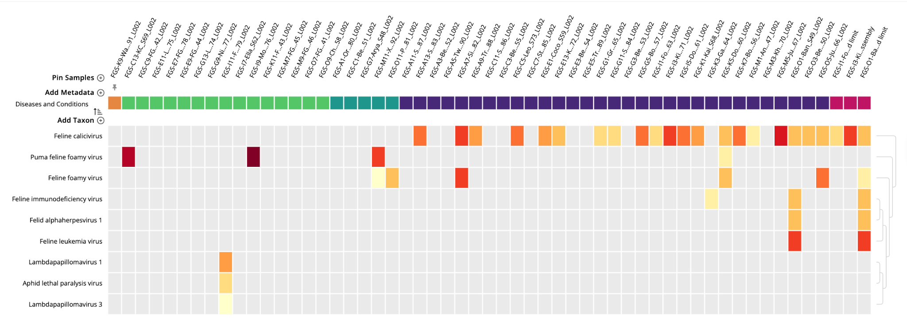
You can override sample clustering to organize heatmap
Pin samples to keep samples of interest on the left
Add metadata and sort samples to identify patterns or microbes of interest
Metadata legend:
Orange - water control
Green - healthy cats
Blue - diseased cats
Feline gingivostomatitis
Notes:
Teal - other cats, different symptoms
Pink -

Slide 11
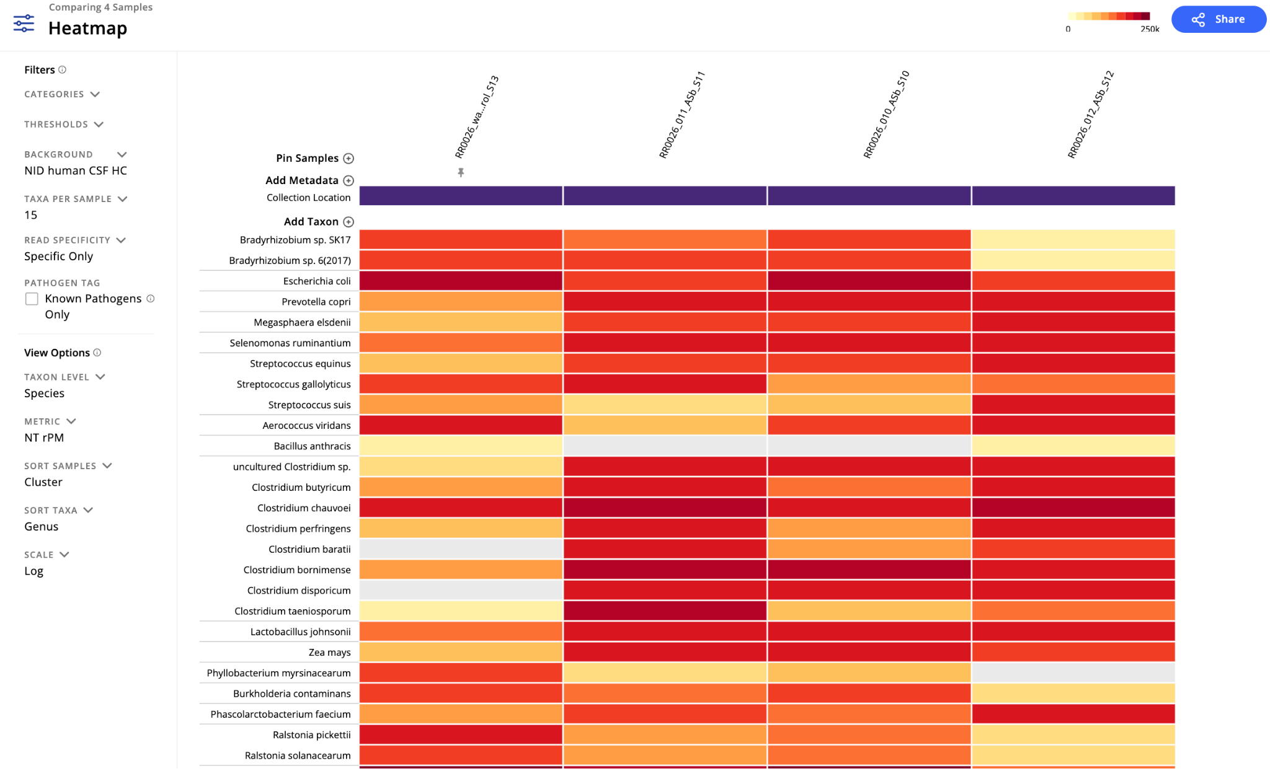
You can override clustering of taxa to organize heatmap
Sorting taxa by genus may help when evaluating contaminants

Slide 12
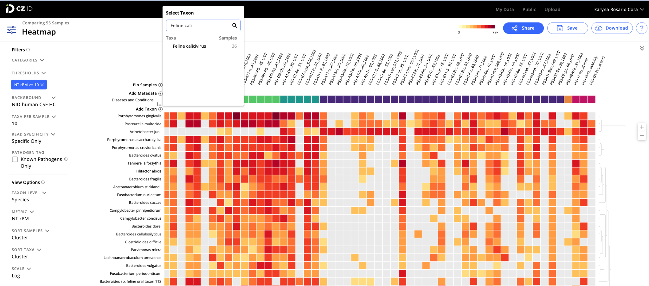
Use “Filters” and “View Options” to explore and reduce noise
Filters
  You can filter by organism category and specific metric thresholds similar to what you use in the Sample Report.
Background
  Search and select the appropriate background to view correct Z-scores
Taxa per Sample
  Use this to increase or reduce the number of top taxa per sample used to create the heatmap
Read Specificity
  Use “Specific only” to see calls at the species level only. Use “All” to see both species calls and unclassified taxa that don’t have complete taxon lineages
Pathogen Tag
  Select to only view known pathogens (based on CZ ID’s Pathogen List)
Taxon Level
  Use to change the taxonomic resolution (species or genus level). Viewing the heatmap at the genus level helps to explore patterns at a broad level
Metric
  Use to change the metric used to create the heatmap (NT rPM by default)
Sort Samples
  You can choose to sort samples alphabetically (this would override sample clustering)
Scale
  You can choose between a logarithmic (Log, default) or linear (Lin) scale
Notes:
Heatmap recalculates every time you change settings! -> If you like your heatmap, save it before changing settings

Slide 13
Use “Add Taxon” to view low abundance taxa of interest
Notes:
Even if your taxa of interest is filtered out for some reason, you can manually add it back in

Slide 14
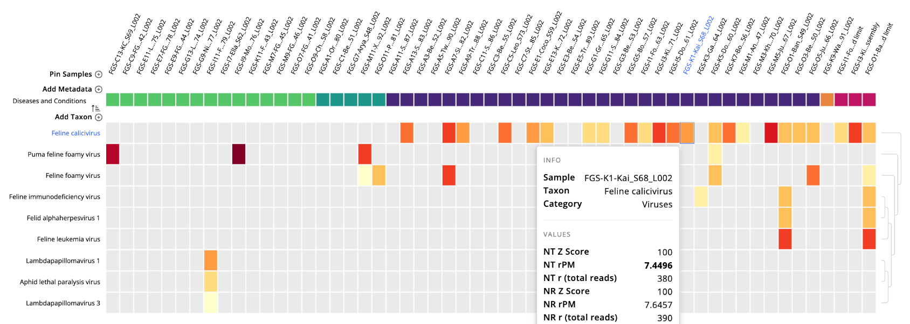
Hover over a cell to see additional metrics
Notes:
Click on the cell to take you to the sample report
Click sample name to open sample details panel

Slide 15
Let’s make a heatmap!
Current Activity: CZ ID Training Reference Tables & Worksheets_Illumina (pg 14-15)
Next Slides (Optional Module): DL9-I_CZ ID AMR Module
Next Slides (Optional Module): DL10-I_Building Viral Consensus Genomes

